Slide 1
CAPSTONE – EOMP#1
Team: Base steps solution

Slide 2
Content
Base steps solution
Team goal
Project overview
Software development process
Risk list

Slide 3
Base steps solution
Mentor: LE SI PHU
Members:
NGUYEN THAI HIEN
TRAN XUAN HAI
NGUYEN HOANG ANH TAI
NGUYEN ANH KHOI
DOAN ANH MINH
NGUYEN XUAN THAI HIEN

Slide 4
Team goal
Mission Statement
Our mission as a team is for everyone to cooperate as well as make decisions as a group so that the team will succeed as an effective entity
What are we supposed to do as a team this term?
As a team, we are supposed to work together as well as help each other when help is required. When a team member is faced with homework or problems which are not fully understood, another teammate can be asked for help.
What are our performance goals?
Our performance goals are to do the best to our abilities, help improve on our weaknesses, and work efficiently and effectively as a team for all tasks presented.

Slide 5
Project overview
Customer: Van Lang University
Represent: NGUYEN THE QUANG
Description: Van Lang University is a non-public university, founded in 1995. Today, the school has 11,000 students enrolled. Every year, the recruitment of 3,000 new students enrolled. So support systems that promote enrollment, and enrollment management is always an important priority.
Goal:
This system manage 3,000 new students enrolled each year.
Students, who enrolled to Van Lang, will know all news and be counseled about admissions by mobile devices.

Slide 6
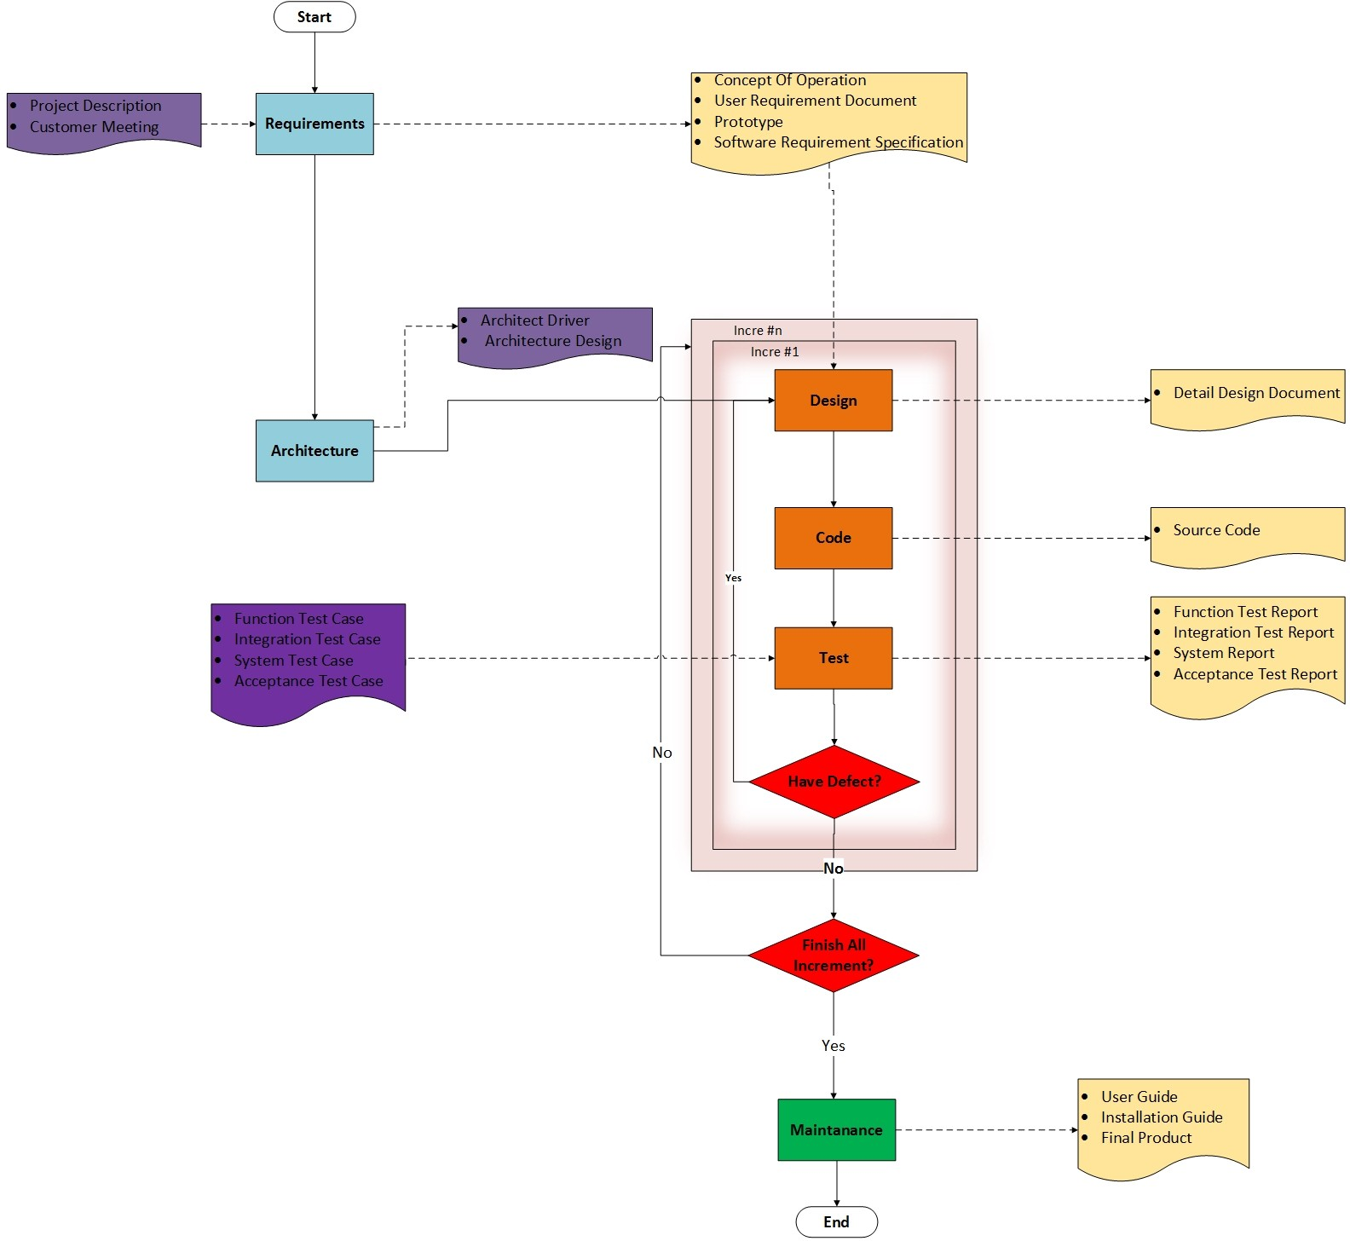
Software development process

Slide 7
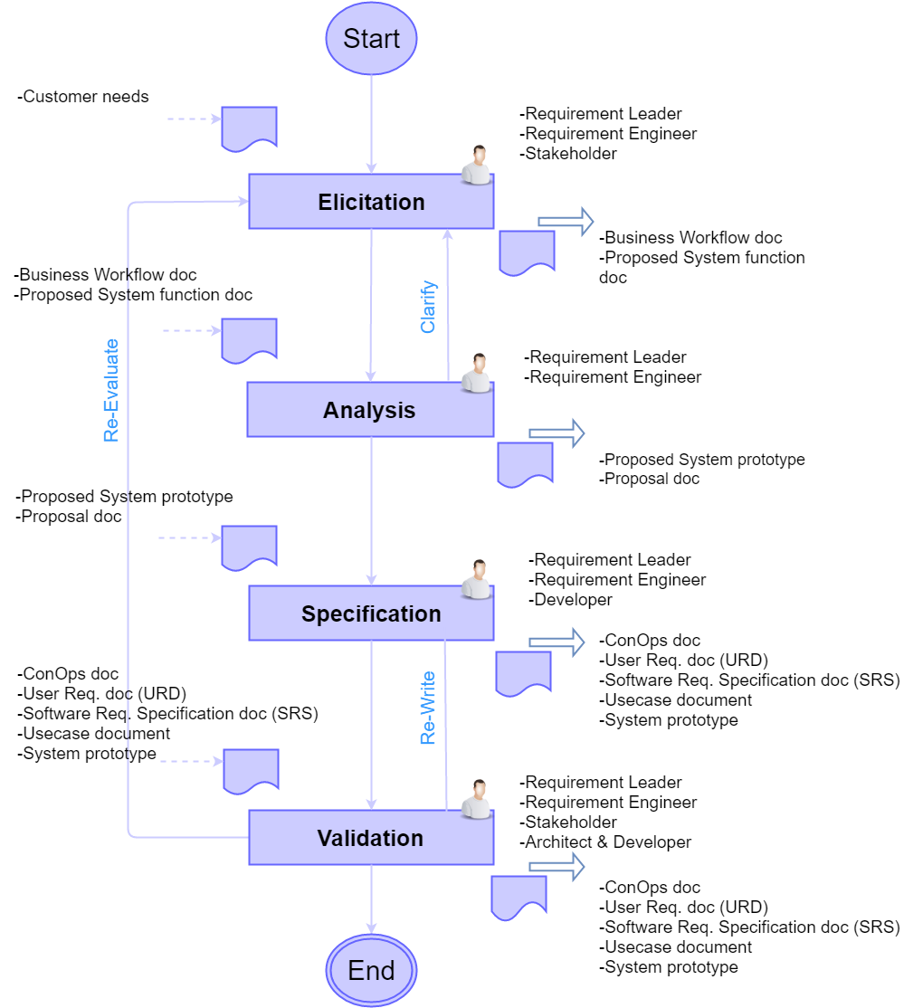
Requirement process

Slide 8
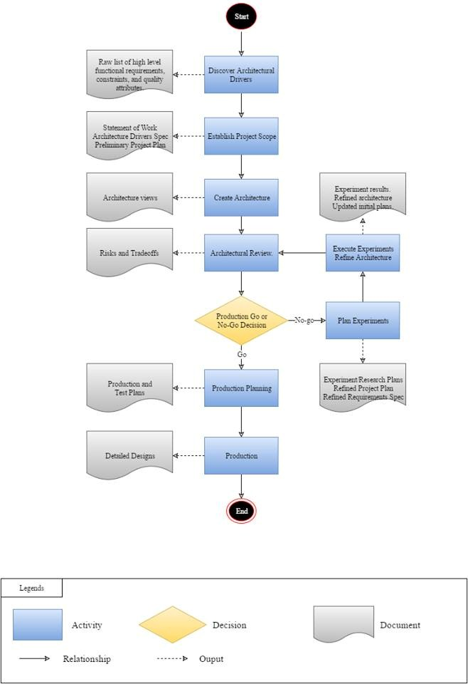
Architect and design process

Slide 9
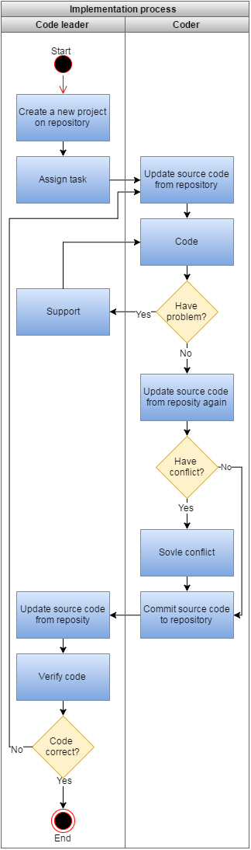
Implementation process

Slide 10
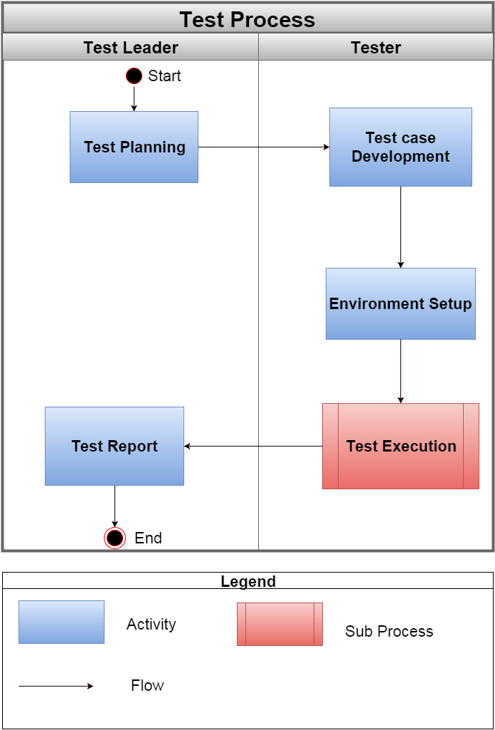
Testing process

Slide 11
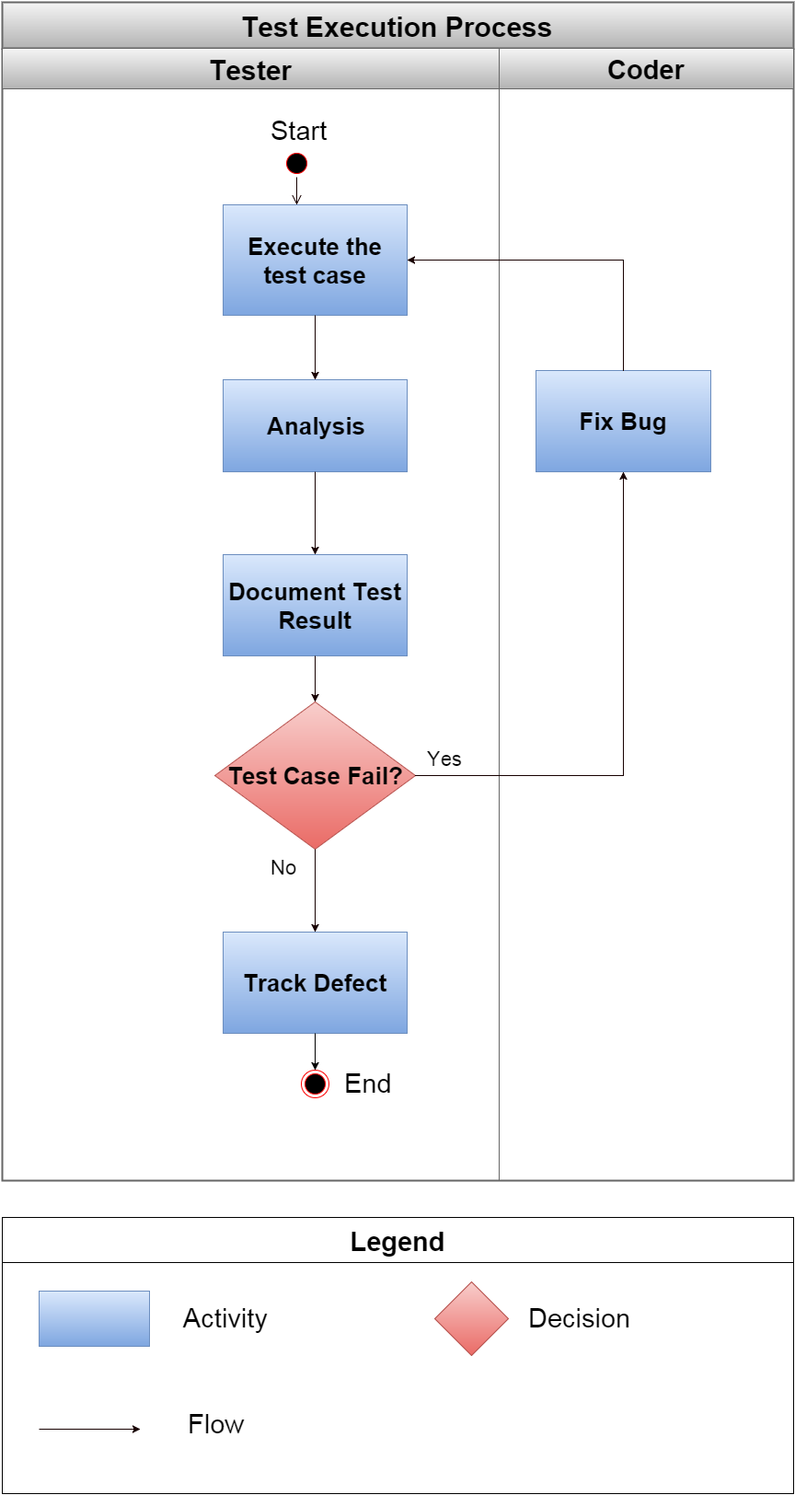
Test execution process

Slide 12
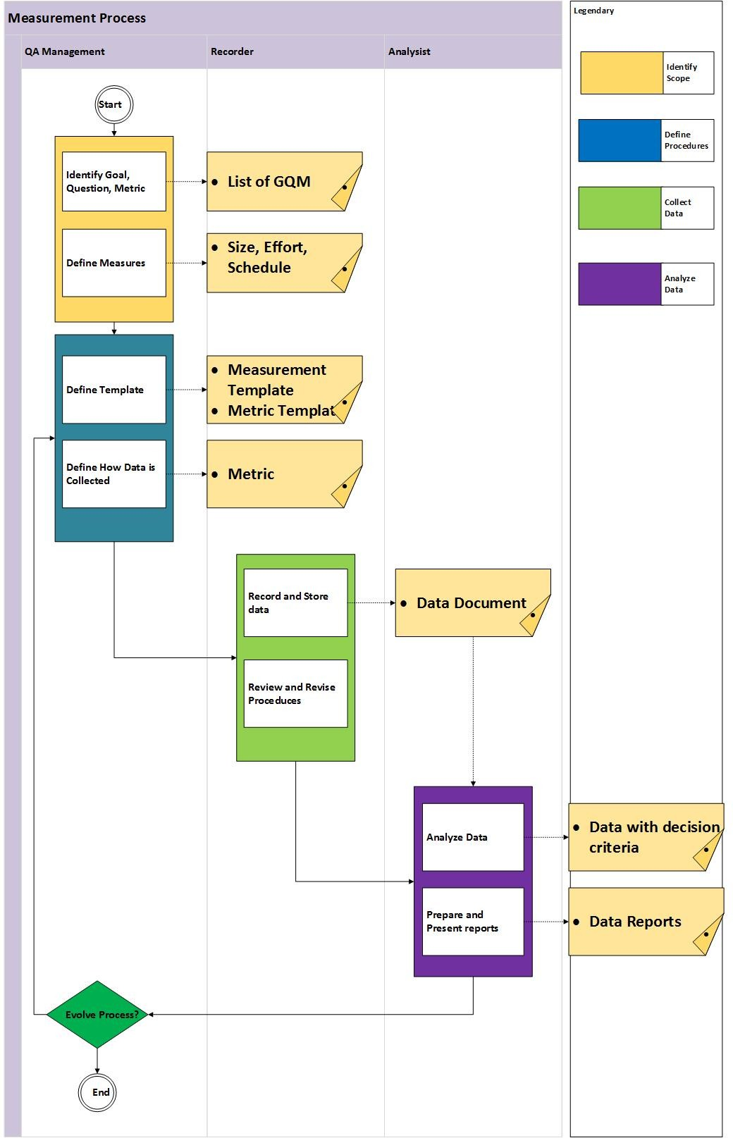
Measurement process

Slide 13
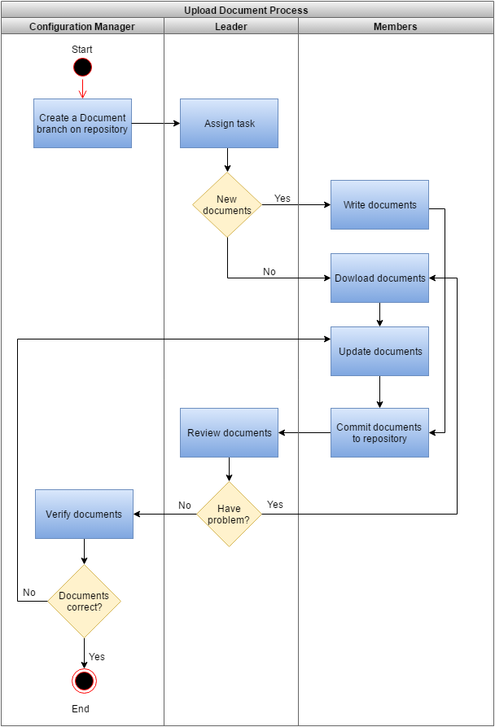
Configuration process

Slide 14
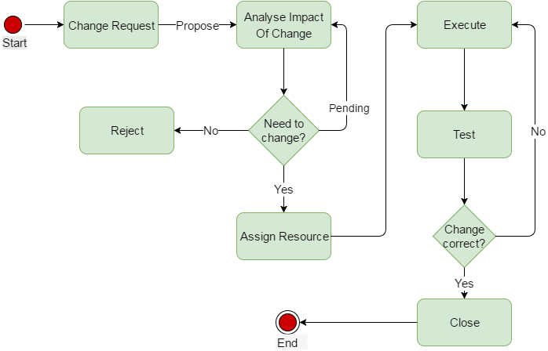
Change process

Slide 15
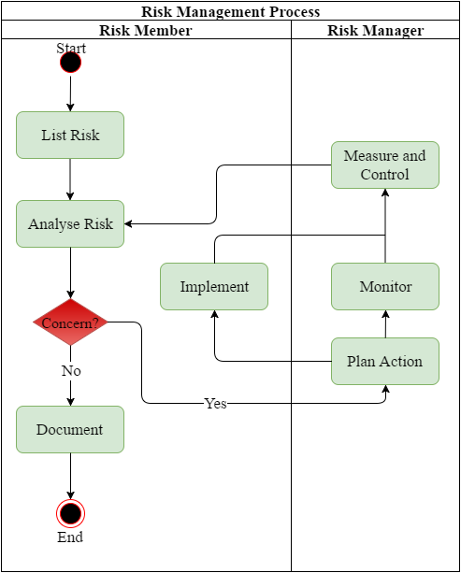
Risk management process

Slide 16
Risk list
No. | Risk | Impact
1 | Team member turnover | Can lead to project disruptions
2 | Lack of needed knowledge | When your project team need to acquire new skills for the project there's a risk that productivity will be low.
3 | Team members have negative attitudes towards the project | Members are negative towards the project may actively or passively sabotage project efforts.
4 | Team motivation is low | This is a particularly common risk lead to productivity is low
5 | Requirements are ambiguous | Requirements are unclear and difficult to analyze. Maybe lead to misunderstand requirements.
6 | Requirements are incomplete | Delay progress
7 | Customer reject the prototype | Spend time to re-design the prototype.

Slide 17
THE END
Thanks for your attentions!

